Slide 1
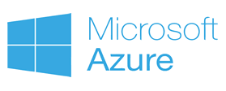


On-Premise to Cloud Migration
Case Study :

Slide 2
Workflow
Legacy media and hard drives delivered by sneaker net
Tag and Ingest the content to eMAM
eMAM prepares proxy copy for web based preview
eMAM sends the content to Archive
Search-Preview-Restore-Download content using eMAM Director
Hard drives are used to restore & deliver large amounts of data

Slide 3
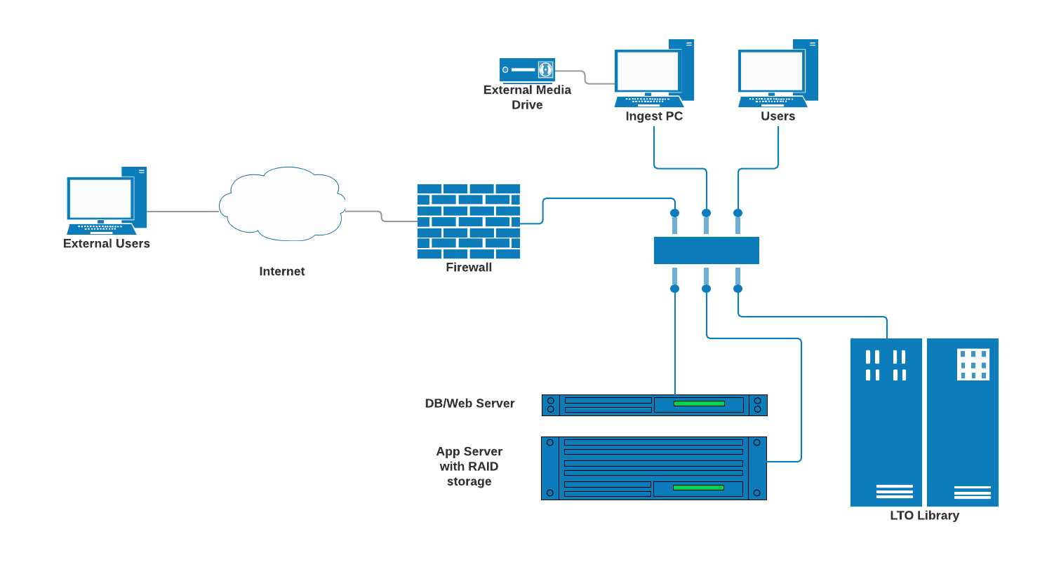
OLD Architecture

Slide 4
Limitations
Outdated LTO Library
RAID storage issues
Tape drive issues
Costly to maintain and expand
Delivery delays due to offline tape handling
Limited access to archived content

Slide 5
Role of Empress / eMAM
Prepared the migration strategy and plan
Deployed parallel eMAM system in Azure
Migrated the database (MSSQL) from on-prem to the cloud
Moved the servers and LTO library to Equinix datacenter for better connectivity to Azure
Made shell scripts to copy the content from tapes to Azure BLOB
Changed the media pointers in the database from LTO to BLOB
Testing and Go Live

Slide 6
Migration challenges
Bad LTO tapes
(Read error, corrupted files)
Delay in servicing Library/Tape Drives (Mechanical failures)
Cache Storage size
(Rate of restore is higher than rate of upload)
Access to the original content during the transition period (Library is used for migration)
Internet connectivity (Moved the system to Equinix datacenter)

Slide 7
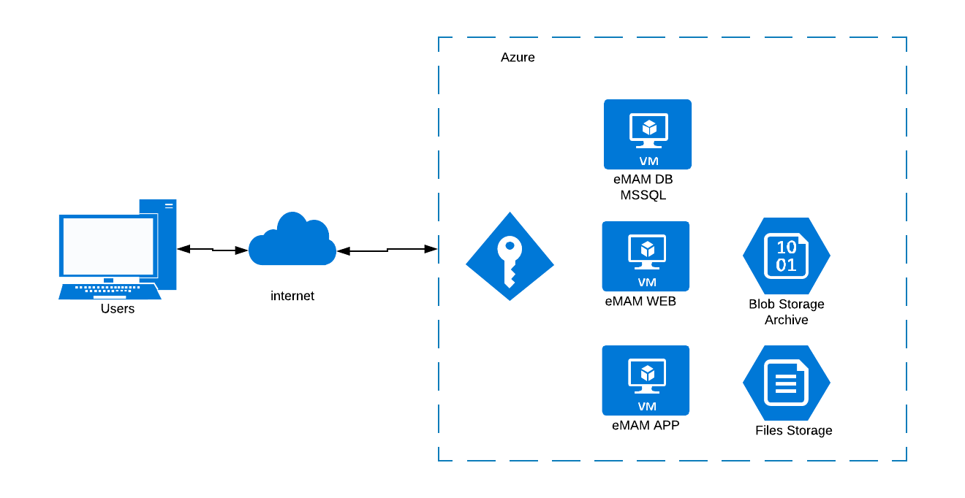
New Architecture with Azure

Slide 8
Advantages
Centralized archive
Predictable retrieval time
Global access to the content
Redundancy
(LRS / GRS)
Scalable
1.5 Million objects
130+ TB
As of 12/09/2018
Cost optimization with “pay-per-use” model
Reduced infrastructure expenses

Slide 9
New Workflow
eMAM Feeder is used to Tag & Ingest the content directly to eMAM
eMAM prepares proxy copy for web based preview
eMAM sends the content to Azure BLOB Archive
Users Search-Preview-Download-Deliver content using eMAM Director

Slide 10
New Opportunities
Cloud Editing and delivery
Artificial Intelligence – Transcript , Faces, objects, keywords extraction
Monetization
Workflow automation

